Slide 1
CLEAN ROOM OPERATING and safety TRAINING
Jiong Hua
Nebraska Center for Materials and Nanoscience
University of Nebraska
NCMN Facility Training
Lincoln, Nebraska
June 19, 2012

Slide 2
Introduction: CLEAN ROOM
WHAT IS A CLEANROOM?
A Cleanroom is a specially designed & constructed room in which the air supply, air distribution, filtration of air supply, materials of construction, and operating procedures, are regulated to control airborne particle concentrations to meet appropriate cleanliness levels.

Slide 3
Introduction: CLASSIFICATION
CLEANROOM CLASSIFICATION
Particles per Cubic Metre
ISO 14644 | 209E | 0.5 Micron | 5 Micron
3 | 1 | 35 | N/A
4 | 10 | 352 | N/A
5 | 100 | 3520 | 29
6 | 1,000 | 35,200 | 293
7 | 10,000 | 352,000 | 2,930
8 | 100,000 | 3,520,000 | 29,300

Slide 4
Introduction: CONTAMINATION
WHERE DOES CONTAMINATION COME FROM?
• Equipment, Material & Processes in the Cleanroom produce contamination.
• The largest single controllable source of contamination enters the Cleanroom with the associates that work there.

Slide 5
Introduction: CONTAMINATION
ASSOCIATE CONTAMINATION
0.5 Micron Particles / Minute | Street Clothing | Bouffant & Frock | Overall & Hood
Sitting | 302,000 | 112,000 | 7,450
Swinging Arms | 2,980,000 | 300,000 | 18,700
Twisting Upper Body | 850,000 | 267,000 | 14,900
Walking | 2,920,000 | 1,010,000 | 56,000

Slide 6
Clean room Protocol
BEFORE ENTERING THE CLEANROOM
• Clean your hands & face
• Use lotions and soap to reduce skin flaking.
• Avoid skin contacts with solvents.
• Wearing cosmetics and skin medications is NOT permitted.
No one or any tool or test instrument enters a Cleanroom area without first obtaining permission of the Cleanroom Supervisor, and must read all rules, regulations, and safety procedures for the Cleanroom.

Slide 7
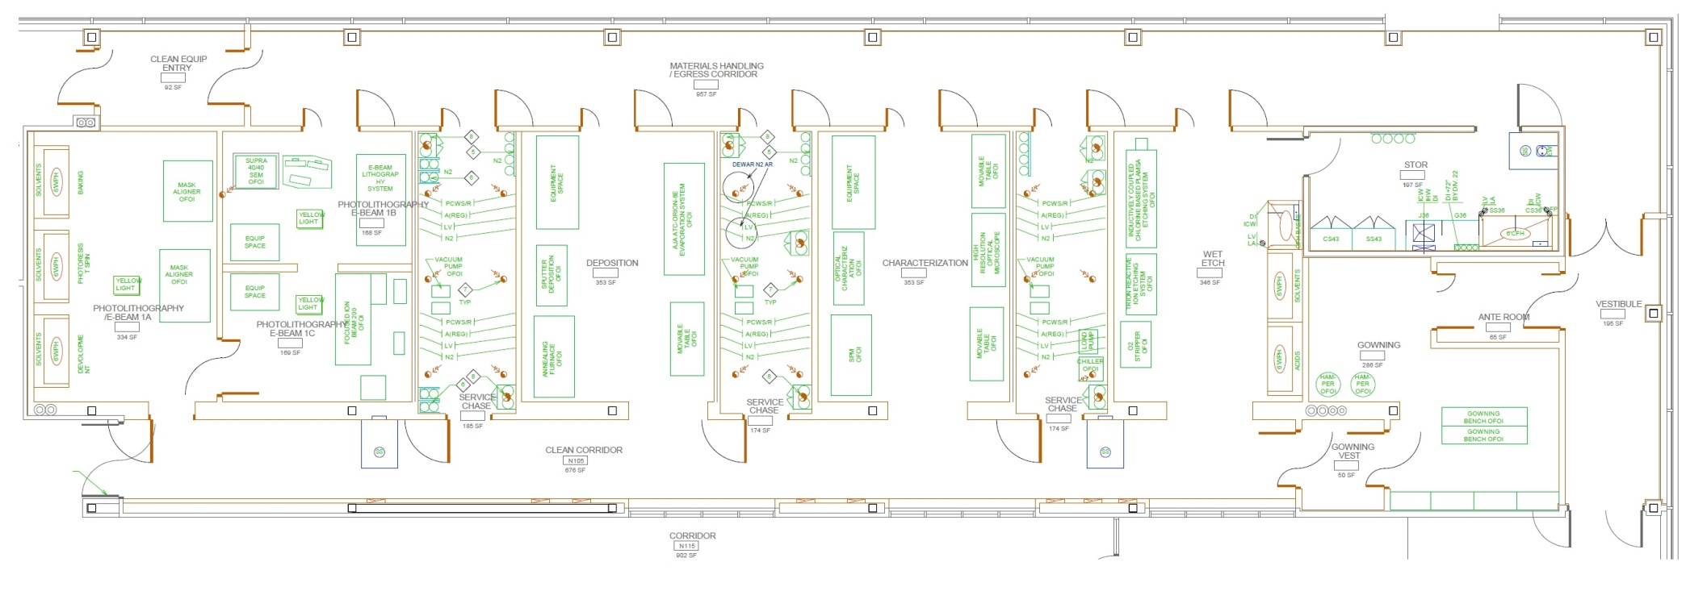
Clean room protocol
Entry area 2
Service area
Storage room
Clean Room area
Gowning area
Entry area

Slide 8
Clean room protocol
Clean Room area
Gowning area
Entry area

Slide 9
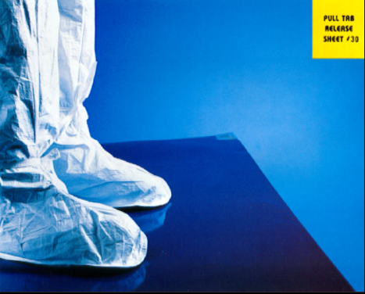
Clean room Protocol: tacky mat
CLEANROOM ENTRY
In the entry area and upon Entering the
Cleanroom, use the tacky mat to capture any loose dust. Step on the mat a minimum of 5 times per foot.

Slide 10
Clean room protocol
Clean Room area
Gowning area
Entry area

Slide 11
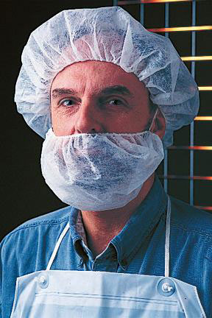
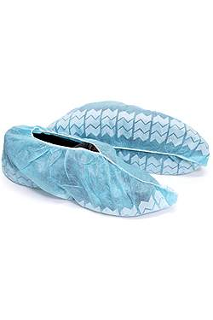
Clean room Protocol: Gowning
GOWNING PROCEDURES
(Entry Area)
• Hair Covers must cover ALL exposed hair, and not just be left sitting on top of your head.
• Beard cover must be used if needed
• All hair covers, beard covers and shoe covers should NOT be reused.

Slide 12
Clean room protocol
Clean Room area
Gowning area
Entry area

Slide 13
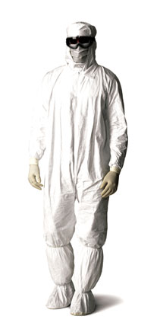
Clean room Protocol: Gowning
GOWNING PROCEDURES
(Gowning Area)
• Gowns must be completely on prior to Cleanroom area, and should not be removed, until you have reached the designated change area.
• Proper Size Garments must be used.
• Gowning should be done from the head down. Donning the hood first, then the coverall, then the booties, to prevents particles from the head, from falling on the garments.
• gloves and safety glasses are required all the time.
You MUST NOT Leave the Cleanroom with your Garment and Head Cover On and Return

Slide 14
Clean room protocol
Clean Room area
Gowning area
Entry area

Slide 15
Clean room Protocol: Gowning
GOWNING PROCEDURES
(Cleanroom Area)
• Required gowning, safety glasses, gloves & booties to be worn at all times.
• Garment users must never allow the garment to touch or drag on the floor.
• The outside surface of the garment should be kept as clean as possible.
• The outside of the garment should not be touched by the inside of the garment, to eliminate the possibility of particles being transferred from the inside to the outside.

Slide 16
Clean room Protocol: Conduct
CLEANROOM CONDUCT
• Restricted activities and products in a Cleanroom are:
• Food, Drink, Gum and Tobacco Products
• Lubricants, Petroleum Products,
• Aerosols
• Duct Tape, Cardboard, Leather
• Cutting or Grinding
• Non-shedding paper and pens are to be used. Pencils and erasers are NOT permitted.
• Equipment, tools, instruments & materials (with permission only) must be cleaned before entry.
• Use containers to transfer and/or store materials.

Slide 17
Clean room Protocol: Conduct
CLEANROOM CONDUCT
• Restricted Entry Area.
• Cleanzones within a Cleanroom are operated at different pressures to control airflow and particle control.
• It is for this reason that all doors must be kept closed.
• Emergency Exits are just as important, but they are there for Life Safety Only

Slide 18
Clean room: Emergency plan

Slide 19
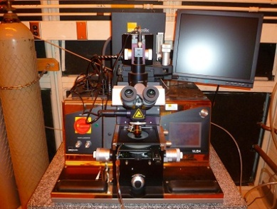
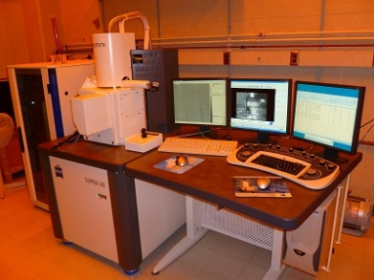
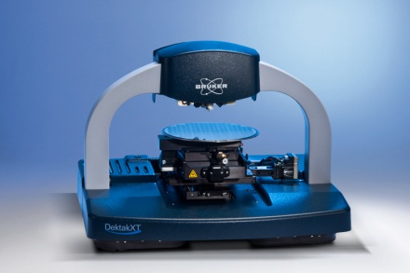
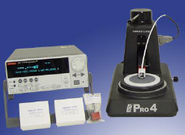
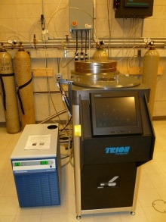
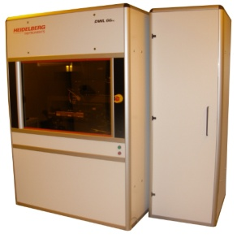
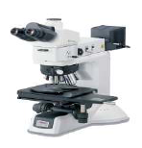
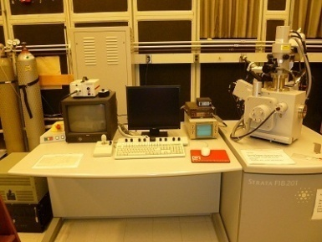
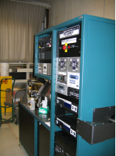
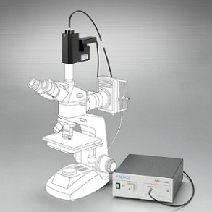
Clean room: floor plan

Slide 20
Safety Training and more information
Required safety training
General Safety and Compliance Information for Everyone
Chemical Safety
General Laboratory Hazards
Contact information: Jiong Hua, Facility Specialist
N101B Voelte-Keegan Nanoscience Research Center (402) 472-3773
jhua2@unl.edu
Send your N-card number to Terese, tjanovec3@unl.edu to active the permission of card reader at clean room entrance.

