Slide 1
Nanotechnology
“Teaching Tiny”
Presenters: Larry Browning,Terese Janovec and Steve Wignall
Nebraska Center for Materials and Nanoscience

Slide 2
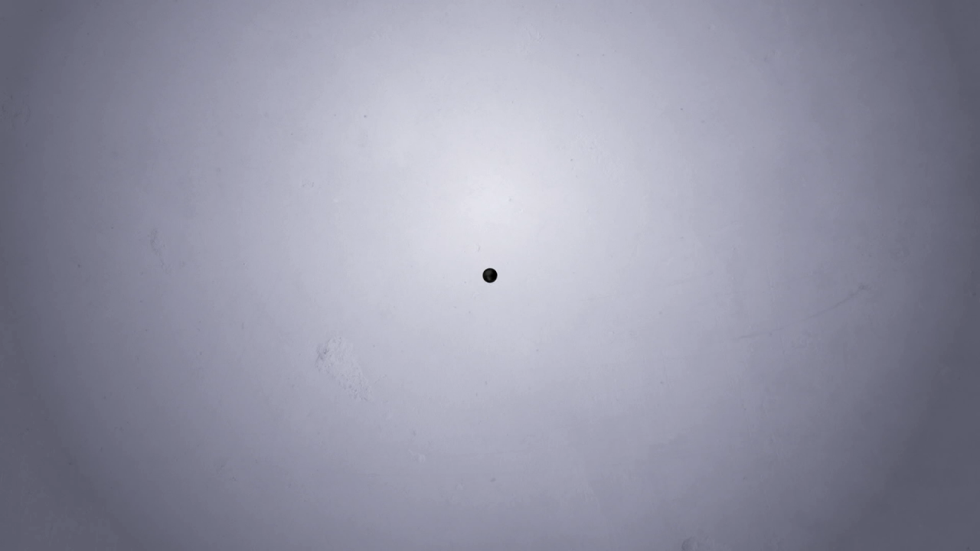
Intro to Nanotechnology

Slide 3
Materials and Nanoscience
Some of the following concepts will be an introduction of Nanotechnology and examined through the final activities with the Nano-Kits.

Slide 4
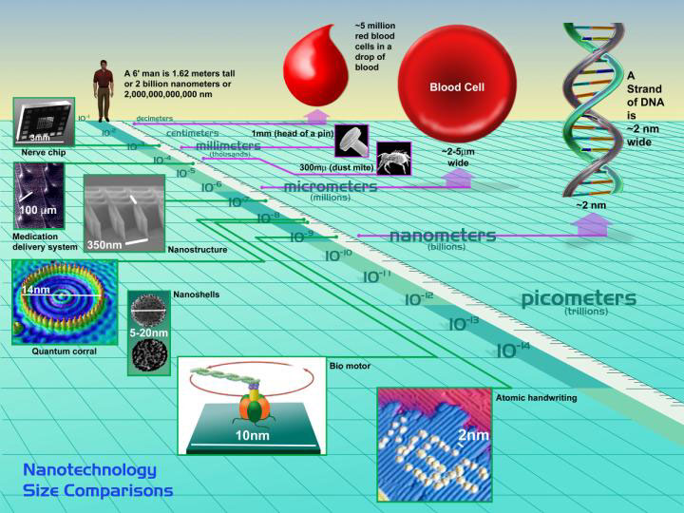
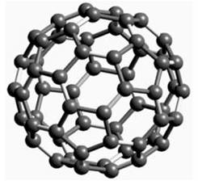
1 nanometer (nm)
One Billionth of a Meter
Human, approx.
2 Billion nm tall
2.5 µm
Nanoscale: 1 nm to 500 nm
Buckyball 1 nm
Nanopedia, Case
Western Reserve University

Slide 5
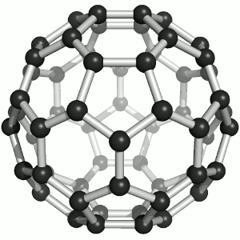
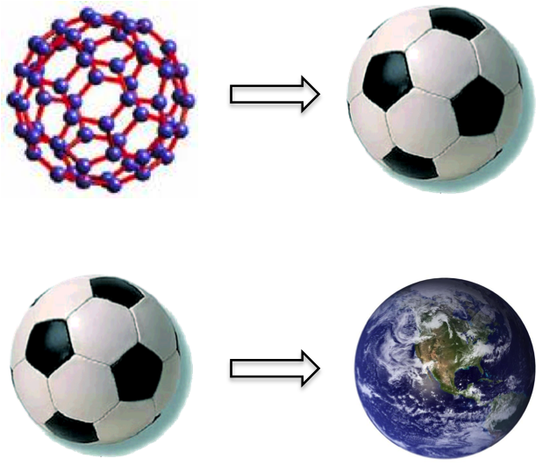
How Big is a Nanometer?
Carbon Nanoparticle
about 1 nm across
Also Called:
C-60, Fullerene, Buckyball
http://www.unl.edu/ncmn/outreach-edu-nanocamp-2013

Slide 6
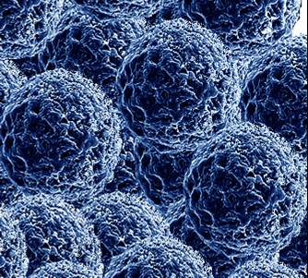
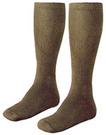

Nano Socks!
Silver Nanoparticles 19 nm across have antimicrobial properties.
They make ArcticShield™ Socks odor and fungus resistant

Slide 7
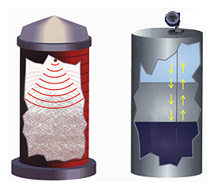

nanobits… Hyperthermal Therapy
4. Heat nanoparticles
with radio waves.
1. Coat magnetic nanoparticles with biocompatible molecules.
tumor
3. Draw nanoparticles to the tumor with a magnet.
patient
5. Melt your tumor away.
2. Inject nanoparticles into the patient.
Prof. Diandra Leslie-Pelecky, UNL Department of Physics and Astronomy

Slide 8
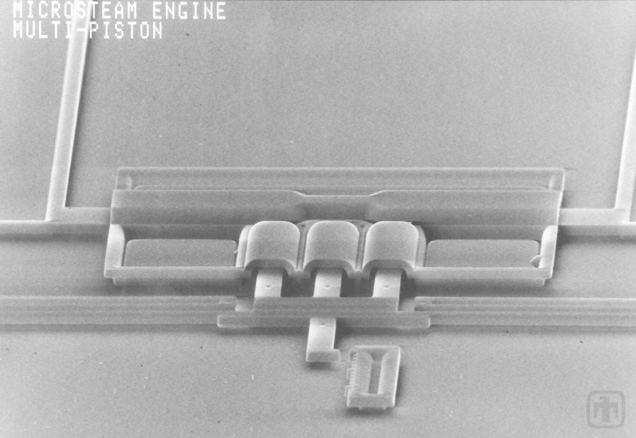

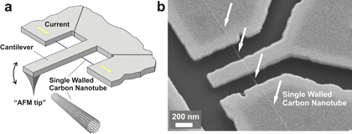
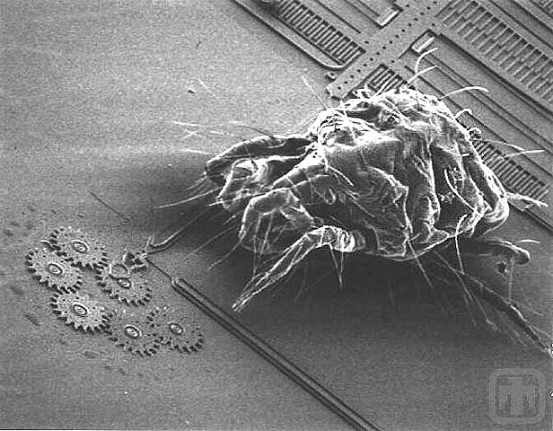

NanoTechnology
1959: Richard Feynman kicks off the nanotechnology era with his provocative lecture “There’s Room at the Bottom”, a scheme for building machines, which build
smaller replicas of themselves, which build
smaller replicas of themselves, which build
smaller replicas of themselves, which build
smaller replicas of themselves, which build
smaller replicas of themselves, which build
. .. … .. . .
1980: Micro-Electro-Mechanical (MEMS) and other microscale machinery.
2000: Nano-Electro-Mechanical (NEMS) devices.
http://www.mems.sandia.gov/
5 µm
steam engine
500 nm
“NanoTube”
1 nm
50 µm
½ mm
1 nm
“Buckyball”
spider mite with gears

Slide 9
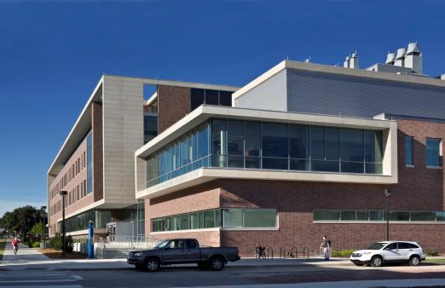
Nanoscience Research at the University of Nebraska
Voelte-Keegan Nanoscience
Research Center
http://research.unl.edu/research_videos/

Slide 10
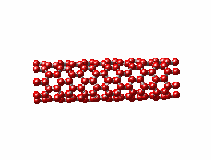
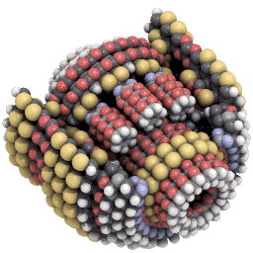
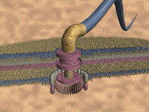
NanoMotors
Carbon Nanotube
about 1 nm across

Slide 11
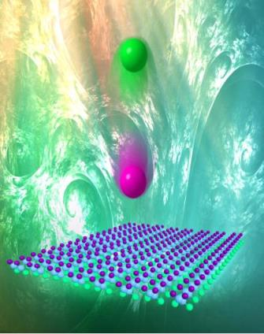
Nanoscience Research at the University of Nebraska
Polymer
SolarCells
http://research.unl.edu/research_videos/

Slide 12
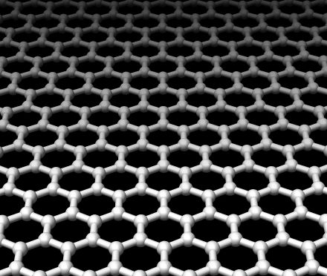
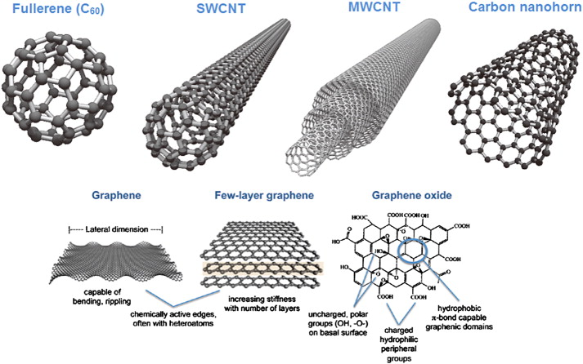
NanoSheets
Graphene
Carbon Sheet
about 1/10 nm thick

Slide 13
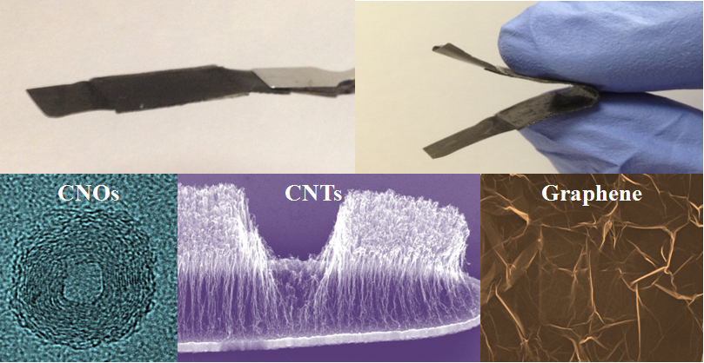
Nanoscience Research at the University of Nebraska
Kale!
http://research.unl.edu/research_videos/

Slide 14
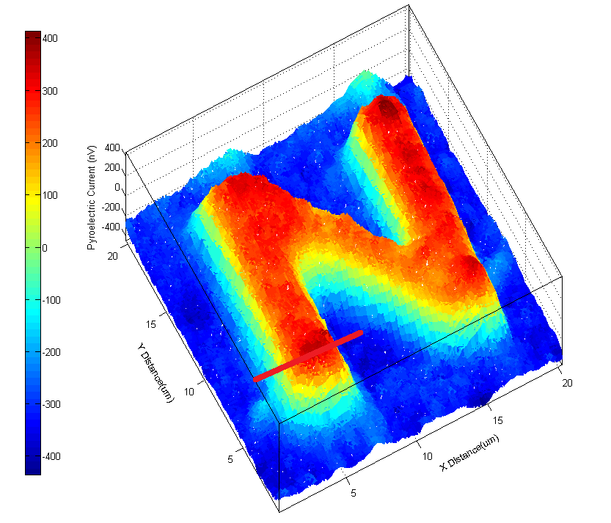
Nanoscience Research at the University of Nebraska
NanoPhysics
Microscopes
http://research.unl.edu/research_videos/

Slide 15
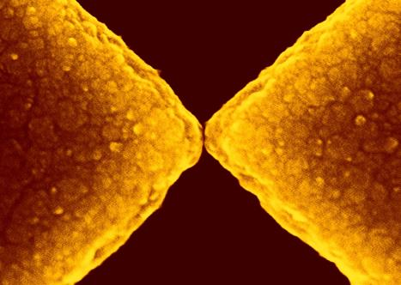
Nanoscience Research at the University of Nebraska
Synthetic Bone Replacement
http://www.unl.edu/ncmn/videos.shtml

Slide 16
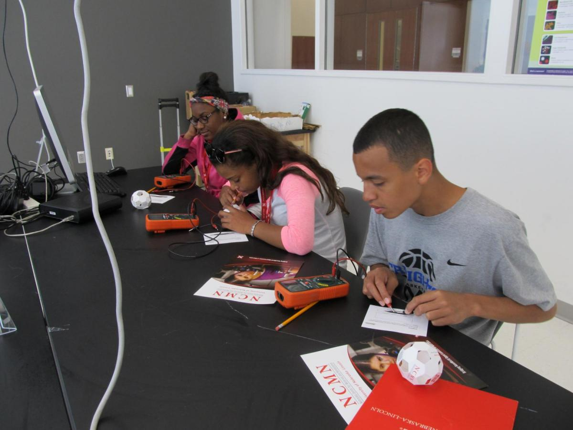
Teacher
Resources

Slide 17
Educational Outreach Teacher Resources
NCMN provides numerous educational events throughout the year to engage student audiences in nanoscale science, technology, and engineering. A variety of methods and tools are used to increase the understanding of participants about science which are available below.
Nano/STEM Digital kits contain hands-on activities, programs, digital downloads complete with resources on getting started, posters, lesson plans, supply lists, marketing materials, training, multimedia files, and more.
Kits can be adapted for different ages, contain reuseable hands-on activities, and cost a nominal fee of $50 per kit. Some Nano/STEM kits are available for order by schools and other non-profits at http://ncmn.unl.edu/kit-order-form. We will invoice and ship kits within a few weeks.
NanoCamp Powerpoints and other Media Resources help support lessons about a variety of topics.
Nebraska Center for Materials and Nanoscience

Slide 18
Kits for Purchase
Ordering: Visit http://ncmn.unl.edu/kit-order-form to purchase one or more kits for your school (non-profit required for order). We will invoice and ship kits within a few weeks.
Exploring Materials—Thin Films
Exploring Materials—Graphene
Exploring Products—Nano Sand (State Standards)
Exploring Products—Liquid Crystal Displays (State Standards)
Exploring Properties—Invisibility (State Standards)
Exploring Materials—Memory Metal (State Standards)
Exploring Materials—Ferrofluid (State Standards)
Exploring Materials—Oobleck
Exploring Size—Measure Yourself

Slide 19

Rain Project
Remotely Accessible Instruments for Nanotechnology

Slide 20
RAIN Sites across the United States
Nano4me.org

Slide 21
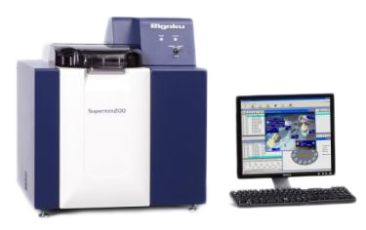
X-ray fluorescence (XRF)
Remote Accessibility:
Nebraska Nanoscale Facility - (Rigaku Supermini200 X)
X-ray fluorescence (XRF) is the emission of characteristic "secondary" (or fluorescent) X-rays from a material that has been excited by bombarding with high-energy X-rays or gamma rays. The phenomenon is widely used for elemental analysis and chemical analysis, particularly in the investigation of metals, glass, ceramics and building materials, and for research in geochemistry, forensic science, archaeology and art objects such as paintings and murals.

Slide 22
RAIN Outreach
Nebraska Nanoscale Facility and 4H Summer Partnership
Nebraska Nanoscale Facility (NNF), in partnership with the University of Nebraska Extension Office and 4-H program provided remote analysis services through RAIN to youth in Omaha this summer. Fourteen schools and various programs throughout Omaha participated in the Engineering with Nano Power experience. Students were introduced to how specialized nano equipment can be used to analyze environmental materials and new products being developed in our society. Using the XRF a variety of materials were examined and their compositions discussed in the classroom after utilizing the remote technical capabilities of the XRF. Youth were able to connect and relate with a real nanoscientist using the RAIN platform. A variety of questions helped students engage with the remote session such as: Why is analyzing samples important? What can you do with the info? What does this analysis tell us and how do you become a nanoscientist?
Nebraska Nanoscale Facility (NNF), in partnership with the University of Nebraska Extension Office and 4-H program provided remote analysis services through RAIN to youth in Omaha this summer. Fourteen schools and various programs throughout Omaha participated in the Engineering with Nano Power experience. Students were introduced to how specialized nano equipment can be used to analyze environmental materials and new products being developed in our society. Using the XRF a variety of materials were examined and their compositions discussed in the classroom after utilizing the remote technical capabilities of the XRF. Youth were able to connect and relate with a real nanoscientist using the RAIN platform. A variety of questions helped students engage with the remote session such as: Why is analyzing samples important? What can you do with the info? What does this analysis tell us and how do you became a nanoscientist?
Over 190 students, 4th-8th grade, were able to experience the RAIN sessions, about 45% were females and 70% from underrepresented groups. We believe the RAIN sessions with enthusiastic teachers and scientists working together can have a positive impact on STEM identity formation and career orientation for youth!
Over 190 students, 4th-8th grade, were able to experience the RAIN sessions, about 45% were females and 70% from underrepresented groups. We believe the RAIN sessions with enthusiastic teachers and scientists working together can have a positive impact on STEM identity formation and career orientation for youth!

Slide 23
Thank you.
Any Questions?
Lets look at some of the Activities!?

Slide 24
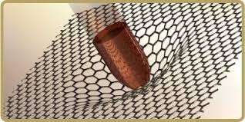
Activities
Graphene, Ferrofluids and Memory Metal
Memory Metal
Ferrofluids
Graphene

Slide 25
Thank you!
Any Questions?

