Slide 1
Unusual Phase Transitions: Shape Memory Materials and “Hot Ice” Peter Beierle
UNL NCMN Nanocamp
Friday: 6.29.2012

Slide 2
N.b:
This powerpoint was not presented on 6.29.12, but serves as the planned discussion for the demonstration that took place.
-Peter Beierle

Slide 3
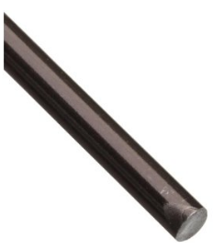
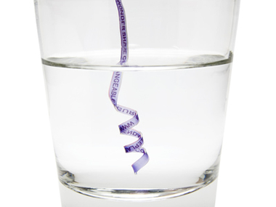
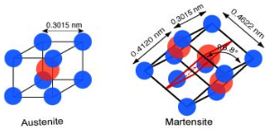
Shape Memory Materials
Nickel Titanium Alloy (NiTinol)
Polymer:

Slide 4
What is A Shape Memory Material?
Shape memory materials: after its shape is changed (ex. bending it to look different), it can change back to one of its previous shapes when exposed to a change in its environment

Slide 5
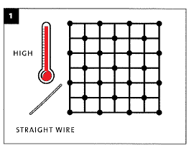
How does it work? Initial cycle
Step 1: Austenite Phase
High Temperature
The atoms arrange themselves in their “permanent” shape

Slide 6
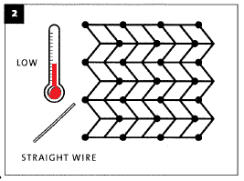
How does it work? Initial cycle
Step 2: Martensite Phase
Low temperature
Cubic structure becomes folded or twined

Slide 7
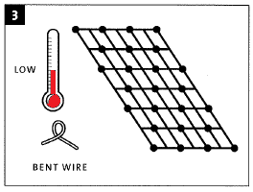
How does it work? Initial cycle
Step 3:
Bend the Wire
It remains in its Martenesite Phase

Slide 8
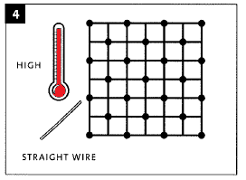
How does it work?
Step 4: Austenite Phase
Heat the wire above the transition temperature of 50 degrees
It moves back to its original position!

Slide 9
Question:
So is the wire being straight the “preferred” shape of the material?

Slide 10
Not Quite!

Slide 11
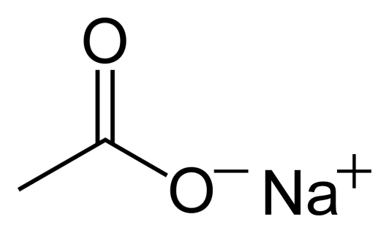
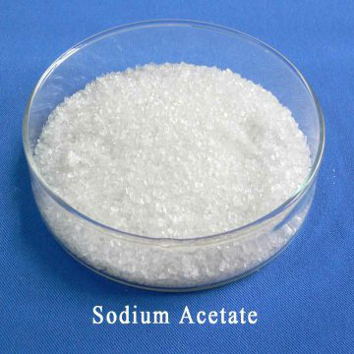
“Hot Ice” experiment setup
Sodium Acetate
Mixed into water
With hotter water more Sodium Acetate can dissolve into the water than otherwise

Slide 12
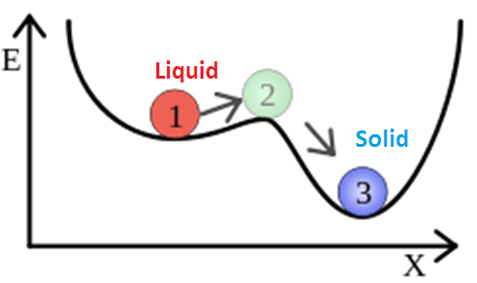
The Mixture Is cooled down in its liquid phase and remains in an metastable state until a small amount of energy pushes it over to become a solid

Slide 13
Questions
How does the Memory Shape Materials Differ and “Hot Ice” differ from their ordinary counterparts
What does these Memory Shape Materials have In common with “Hot Ice”?

Slide 14
References
Phase Transitions images:
Nova: Making Stuff Smarter, Educational Innovations, Inc.
Ninitol Image:
Amazon: small parts, Wikipedia,
Sodium Acetate Images:
Wikipedia, Hi. World Trade Center

