Slide 1
Nano and Magnets
2015 NCMN NanoCamp

Slide 2
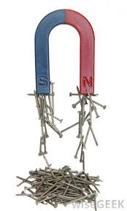
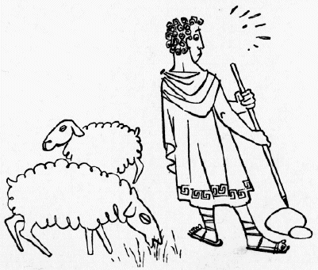
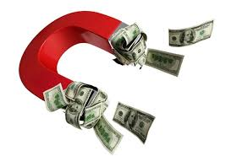
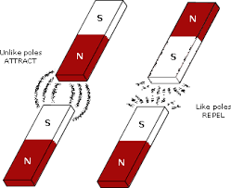
What’s a magnet?
Magnets attract iron (discovered by Magnes).
magnets attract or repel other magnets.
Magnets has two poles (south and north).

Slide 3
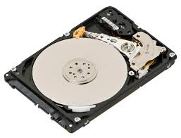
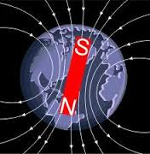
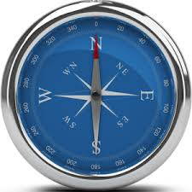
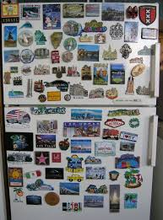
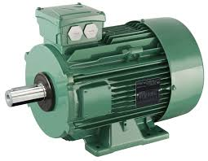
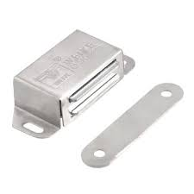
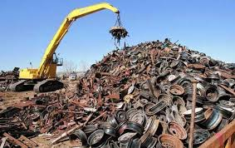
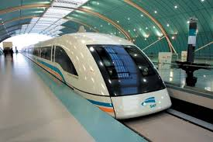
Example of magnets and applications
The earth
Fridge magnets
Door magnets
Compass
Motors
Computer hard drives
Junkyard lifting
Magnetic levitated train (270 miles/hour)

Slide 4
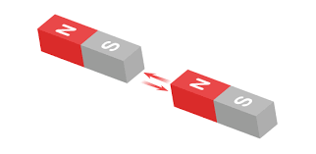
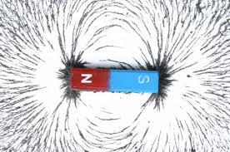
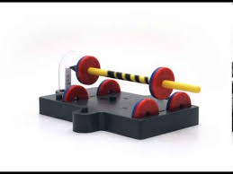
Why magnets attract or repel each other?
One magnet generates a field, which attract and repel other magnets
No contact is necessary
This makes the levitation possible!

Slide 5
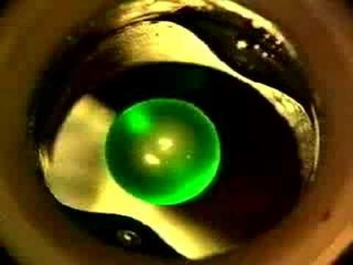
Magnetic levitation of water in 30 tesla magnetic field (700,000 times the earth magnetic field.

Slide 6
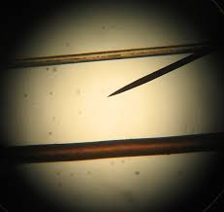

Nanomagnets: Extremely small magnets:
1 nanometer = 1 billionth ($\frac{1}{1,000,000,000}$) meter
The human hair is 40,000 nanometer in diameter.
Why do we need nanomagnets ?

Slide 7
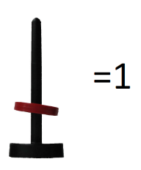
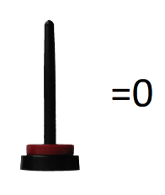
We use magnets to store information
Pictures, video, music, e-books are stored using binary codes in computers.
1 magnet is a bit.
8 bit is a byte.
A typical mp3 is about 5 mega bytes, or 5 million bytes.
Letter Binary Code
a 01100001
b 01100010
c 01100011
d 01100100
e 01100101

Slide 8
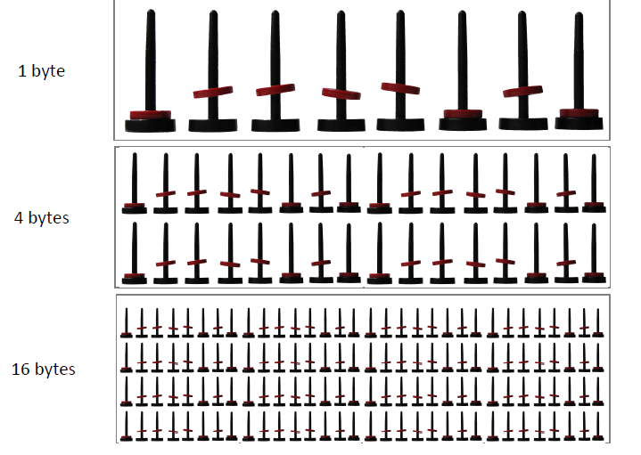
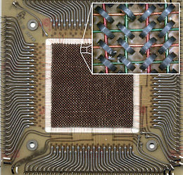
We use magnets to store information
The smaller the magnet, the more information we can store.
The magnets in today’s hard drives are less than 100 nanometer.
The first magnetic core memory uses magnet of 1 mm (0.04 inch) diameter

Slide 9
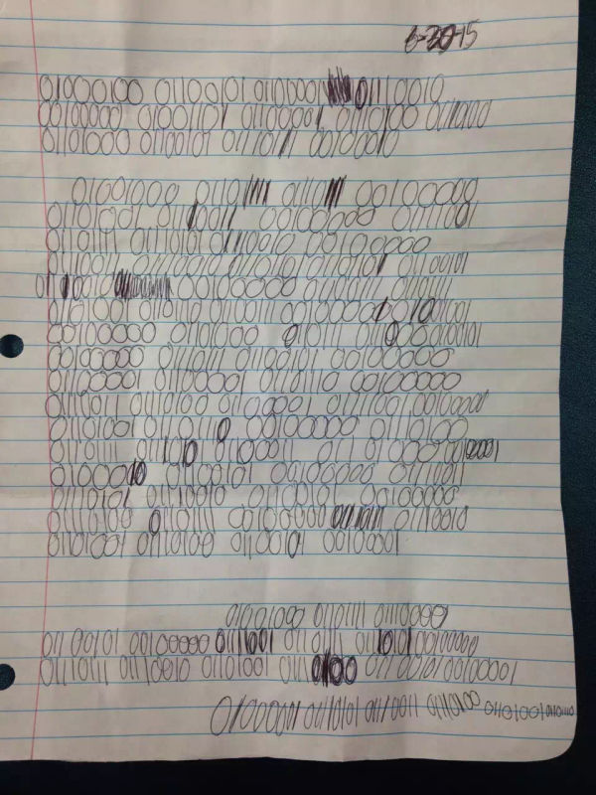
Dear Matthew,
How is your summer going? I hope we can stay in touch. Hope you can write back.
Austin

Slide 10
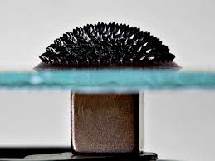
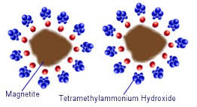
Another example of nanomagnets: ferrofluids
There are tiny magnets suspended in oil.
When there is a magnetic field, the magnets are aligned form beautiful patterns (like a solid!)

Slide 11
Today’s activity: hard drive
Build your own hard drive which stores one letter!
Spell your name in binary code!

Slide 12
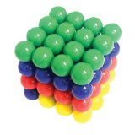
Today’s activity: Ferrofluids and magnetic matrix
Observe the difference between magnetic dust and ferrofluids.
Build your own magnetic matrix!

Slide 13
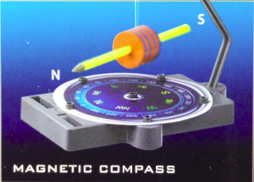
Today’s activity: Magnetic levitation and compass
Build your own anti-gravity motor!
Build your own compass and find our the north and south.

Slide 14
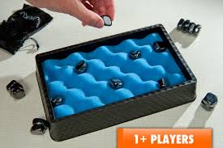
Today’s activity: Jishaku
Play with the power (attractive and repulsive force) of the magnets!
You get to keep a pair of sticky stones (magnets) after your session!

Slide 15
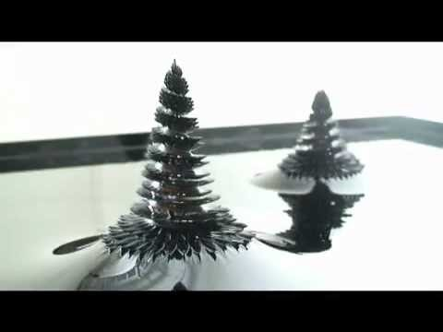

Slide 16

Thank you and have fun!

